Slide 1


Economic Modelling of Energy and Climate Systems Prof. Dr. Thomas S. Lontzek
Project Presentation 1
By: Ilyas O. Demiroz
Project – How Climate Change would Affect Different Countries in Europe?
Model with Unsupervised Machine Learning
Economic Modelling of Energy and Climate Systems | Project Presentation 1 | March 2021

Slide 2
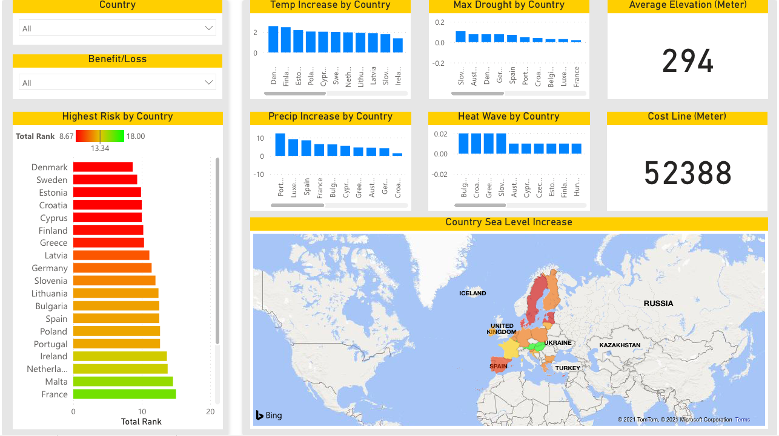
Multiple data source combined to enrich the process of identifying the who benefit/loss by Climate Change
DATA SOURCES
ML MODEL + DASHBOARD
World Bank Group – Low Carbon Emissions (RCP 2.6) predictions
Climate Chage Post – Sea Level Predictions
Global Sustainability Goals
Lecture Notes
Economic Modelling of Energy and Climate Systems | Project Presentation 1 | March 2021

Slide 3
Climate Change Benefit/Loss Dashboard is powered by a Unsupervised Machine Learning Model to identify who benefit/loss by Climate Change Effects
MODEL APPROACH
ML MODEL + DASHBOARD
Hypothesis: the most valunareble countries should have
High Temperature Increase
High Precipitation Increase
High Temperature Anomaly
Largest Single Day Rainfall Anomaly
High Drought
High Heat Wave
High Coast Length
High Increase Sea Level
Low Average Elevation
Economic Modelling of Energy and Climate Systems | Project Presentation 1 | March 2021

Slide 4
Climate Change Benefit/Loss Dashboard is powered by a Unsupervised Machine Learning Model to identify who benefit/loss by Climate Change Effects
MODEL APPROACH
ML MODEL + DASHBOARD
Based on the hypothesis Unsupervised Machine Learning Model was developed to identify benefit/vulnarable countries.
The Model uses a K-Means Clustering Algorithm and Traditional Analytical Techniques.
The model produces 2 clusters (Loss Countries, Benefit or Less Loss Countries) ranked by vulnerabilities of the countries.
Economic Modelling of Energy and Climate Systems | Project Presentation 1 | March 2021

Slide 5
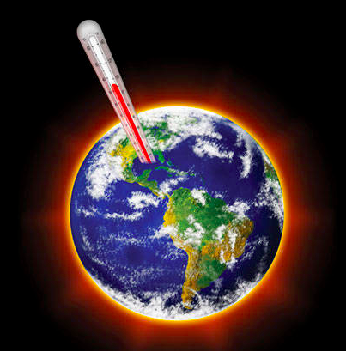
Thank you …
Project Presentation 1
By: Ilyas O. Demiroz
Economic Modelling of Energy and Climate Systems | Project Presentation 1 | March 2021

